Slide 1
College Technical Math 1
Section 9.1
Graphing Linear Equations and Functions

Slide 2
Unit 4
9.1: Graphing Linear Equations and Functions
9.2/19.4(1): Graphing Linear Equations, Distance Formula
9.3: Slope
9.4 : Writing the Equation of a Line

Slide 3
An ordered pair consists of two values written in parentheses, separated by a comma.
$$(x,y)$$

Slide 4
An ordered pair consists of two values written in parentheses, separated by a comma.
$$(x,y)$$
The first value is called the x – coordinate and is also referred to as the domain or input value.

Slide 5
An ordered pair consists of two values written in parentheses, separated by a comma.
$$(x,y)$$
The second value is called the y – coordinate and is also referred to as the range or output value.

Slide 6
Ordered pairs, such as $(x,y)$, are solutions to equations that contain two variables.

Slide 7
Ordered pairs, such as $(x,y)$, are solutions to equations that contain two variables.
Example: Is the ordered pair $\left(4, 5\right)$ a solution to the equation $3x−2y=2$?

Slide 8
Ordered pairs, such as $(x,y)$, are solutions to equations that contain two variables.
Example: Is the ordered pair $\left(4, 5\right)$ a solution to the equation $3x−2y=2$?
$$3x−2y=2$$

Slide 9
Ordered pairs, such as $(x,y)$, are solutions to equations that contain two variables.
Example: Is the ordered pair $\left(4, 5\right)$ a solution to the equation $3x−2y=2$?
$$3(4)−2y=2$$

Slide 10
Ordered pairs, such as $(x,y)$, are solutions to equations that contain two variables.
Example: Is the ordered pair $\left(4, 5\right)$ a solution to the equation $3x−2y=2$?
$$3(4)−2(5)=2$$

Slide 11
Ordered pairs, such as $(x,y)$, are solutions to equations that contain two variables.
Example: Is the ordered pair $\left(4, 5\right)$ a solution to the equation $3x−2y=2$?
$$3(4)−2(5)=2$$
$$12−10=2$$
$$2=2$$
$(4,5)$ is a solution to $3x−2y=2$

Slide 12
Ordered pairs, such as $(x,y)$, are solutions to equations that contain two variables.
Example: Is the ordered pair $\left(6,4\right)$ a solution to the equation $3x−2y=2$?

Slide 13
Ordered pairs, such as $(x,y)$, are solutions to equations that contain two variables.
Example: Is the ordered pair $\left(6,4\right)$ a solution to the equation $3x−2y=2$?
$$3x−2y=2$$

Slide 14
Ordered pairs, such as $(x,y)$, are solutions to equations that contain two variables.
Example: Is the ordered pair $\left(6, 4\right)$ a solution to the equation $3x−2y=2$?
$$3(6)−2y=2$$

Slide 15
Ordered pairs, such as $(x,y)$, are solutions to equations that contain two variables.
Example: Is the ordered pair $\left(6, 4\right)$ a solution to the equation $3x−2y=2$?
$$3(6)−2(4)=2$$

Slide 16
Ordered pairs, such as $(x,y)$, are solutions to equations that contain two variables.
Example: Is the ordered pair $\left(6, 4\right)$ a solution to the equation $3x−2y=2$?
$$3(6)−2(4)=2$$
$$18−8=2$$
$$10≠2$$
$(6,4)$ is a not solution to $3x−2y=2$

Slide 17
When given one of the values of an ordered pair, we can determine the value of the other variable using the given equation.
$$(4,y)$$
$$(x,−2)$$

Slide 18
Example: Complete each ordered pair so that it is a solution of the given equation.
$$x+2y=−6$$
$$x$$
$$y$$
$$1$$

Slide 19
Example: Complete each ordered pair so that it is a solution of the given equation.
$$x+2y=−6$$
$$x+2(1)=−6$$
$$x$$
$$y$$
$$1$$

Slide 20
Example: Complete each ordered pair so that it is a solution of the given equation.
$$x+2y=−6$$
$$x+2(1)=−6$$
$$x$$
$$y$$
$$x+2=−6$$
$$−8$$
$$1$$
$$x=−8$$

Slide 21
Example: Complete each ordered pair so that it is a solution of the given equation.
$$x+2y=−6$$
$$x+2(1)=−6$$
$$x$$
$$y$$
$$x+2=−6$$
$$−8$$
$$1$$
$$x=−8$$
The solution would be the ordered pair $\left(−8,1\right).$

Slide 22
Example: Complete each ordered pair so that it is a solution of the given equation.
$$x+2y=−6$$
$$x$$
$$y$$
$$−8$$
$$1$$
$$4$$

Slide 23
Example: Complete each ordered pair so that it is a solution of the given equation.
$$x+2y=−6$$
$$4+2y=−6$$
$$x$$
$$y$$
$$−8$$
$$1$$
$$4$$

Slide 24
Example: Complete each ordered pair so that it is a solution of the given equation.
$$x+2y=−6$$
$$4+2y=−6$$
$$x$$
$$y$$
$$2y=−10$$
$$−8$$
$$1$$
$$y=−5$$
$$4$$
$$−5$$

Slide 25
Example: Complete each ordered pair so that it is a solution of the given equation.
$$x+2y=−6$$
$$4+2y=−6$$
$$x$$
$$y$$
$$2y=−10$$
$$−8$$
$$1$$
$$y=−5$$
$$4$$
$$−5$$
The solution would be the ordered pair $\left(4,−5\right).$

Slide 26
Example: Complete each ordered pair so that it is a solution of the given equation.
$$x+2y=−6$$
$$x+2y=−6$$
$$x$$
$$y$$
$$−8$$
$$1$$
$$4$$
$$−5$$
$$\frac{3}{2}$$

Slide 27
Example: Complete each ordered pair so that it is a solution of the given equation.
$$x+2y=−6$$
$$x+2\left(\frac{3}{2}\right)=−6$$
$$x$$
$$y$$
$$−8$$
$$1$$
$$4$$
$$−5$$
$$\frac{3}{2}$$

Slide 28
Example: Complete each ordered pair so that it is a solution of the given equation.
$$x+2y=−6$$
$$x+2\left(\frac{3}{2}\right)=−6$$
$$x$$
$$y$$
$$−8$$
$$1$$
$$x+3=−6$$
$$x=−9$$
$$4$$
$$−5$$
$$−9$$
$$\frac{3}{2}$$

Slide 29
Example: Complete each ordered pair so that it is a solution of the given equation.
$$x+2y=−6$$
$$x+2\left(\frac{3}{2}\right)=−6$$
$$x$$
$$y$$
$$−8$$
$$1$$
$$x+3=−6$$
$$x=−9$$
$$4$$
$$−5$$
The solution would be the ordered pair$.$ $\left(−9,\frac{3}{2}\right)$
$$−9$$
$$\frac{3}{2}$$

Slide 30
There are several different forms of a linear equation, but all of the forms have two things in common.
The exponent of every variable is 1.
No term has more than one variable.

Slide 31
Here are the forms of a linear equation that you will work with in this course.
Standard Form
$$Ax+By=C$$
$$Ex: −3x+2y=12$$

Slide 32
Here are the forms of a linear equation that you will work with in this course.
Slope – Intercept (Function) Form
$$y=mx+b$$
$$Ex: y=\frac{3}{4}x−5$$

Slide 33
Here are the forms of a linear equation that you will work with in this course.
Point – Slope Form
$$y−y_{1}=m\left(x−x_{1}\right)$$
$$Ex: y−5=4(x−2)$$

Slide 34
Here are the forms of a linear equation that you will work with in this course.
Horizontal Line Form
$$y=b$$
$$Ex: y=−3$$

Slide 35
Here are the forms of a linear equation that you will work with in this course.
Vertical Line Form
$$x=a$$
$$Ex: x=9$$

Slide 36
Function Notation
As you have probably noticed, when filling in a table of values the function (slope-intercept) form $(y=mx+b)$ of the equation is easier to complete calculations with.
For that reason it is important to know how to convert between the forms of the linear equation.
Note: $f\left(x\right)=mx+b$ is called function notation.

Slide 37
Function Notation
Rewrite $−4x+2y=10$ in function notation. (Example)
$$−4x+2y=10$$
$$2y=10+4x$$
$$y=5+2x$$
$$f\left(x\right)=2x+5$$

Slide 38
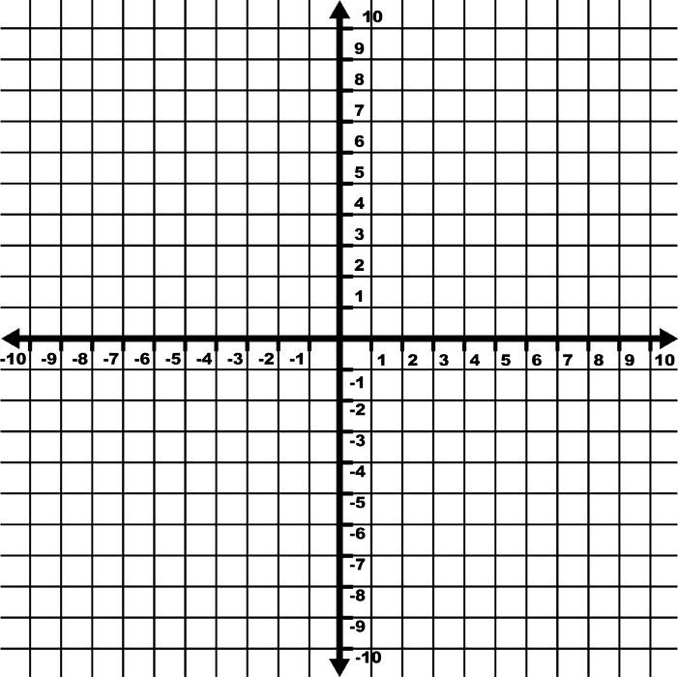
The Cartesian coordinate plane is more commonly known as the rectangular coordinate plane. In this course I may refer to the coordinate plane by either name.

Slide 39
The rectangular coordinate plane consists of two real number lines, called axes.

Slide 40
The rectangular coordinate plane consists of two real number lines, called axes.
The horizontal number line
is called the x – axis.
x - axis

Slide 41
The rectangular coordinate plane consists of two real number lines, called axes.
y - axis
The horizontal number line
is called the x – axis.
The vertical number line
is called the y – axis.
x - axis

Slide 42
The rectangular coordinate plane consists of two real number lines, called axes.
y - axis
The horizontal number line
is called the x – axis.
The vertical number line
is called the y – axis.
x - axis
The intersection point of the two axes is called the origin.
origin

Slide 43
The x and y axis divide the coordinate plane into four equal parts
called quadrants.

Slide 44
The x and y axis divide the coordinate plane into four equal parts
called quadrants.
Quadrant I
Quadrant I

Slide 45
The x and y axis divide the coordinate plane into four equal parts
called quadrants.
Quadrant II
Quadrant I
Quadrant I
Quadrant II

Slide 46
The x and y axis divide the coordinate plane into four equal parts
called quadrants.
Quadrant I
Quadrant II
Quadrant I
Quadrant II
Quadrant III
Quadrant III

Slide 47
The x and y axis divide the coordinate plane into four equal parts
called quadrants.
Quadrant I
Quadrant II
Quadrant I
Quadrant II
Quadrant III
Quadrant IV
Quadrant III
Quadrant IV

Slide 48
The coordinate plane consists of an infinite number of points.
Every point represents a unique location in the coordinate plane.

Slide 49
The coordinate plane consists of an infinite number of points.
Every point represents a unique location in the coordinate plane.
The location of each point is given by an ordered pair.

Slide 50
An ordered pair consists of two values written in parentheses, separated by a comma.
$$(x,y)$$
The first value is called the x – coordinate and gives the horizontal movement in relation to the origin. The x – coordinate is referred to as the domain or input value.

Slide 51
An ordered pair consists of two values written in parentheses, separated by a comma.
$$(x,y)$$
The second value is called the y – coordinate and gives the vertical movement in relation to the origin. The y –coordinate is referred to as the range or output value.

Slide 52
To graph an ordered pair in the
Cartesian plane, do the following:

Slide 53
To graph an ordered pair in the
Cartesian plane, do the following:
Move left or right along the x – axis to the position listed as the x coordinate.
$$− +$$

Slide 54
To graph an ordered pair in the
Cartesian plane, do the following:
Move left or right along the x – axis to the position listed as the x coordinate.
$+$
$−$
Move up or down from the position on the x – axis according to the position listed as the y coordinate.

Slide 55
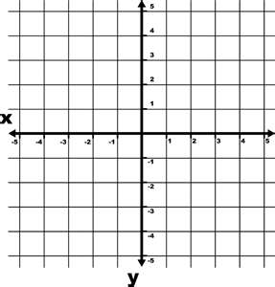
Examples: Plot each
ordered pair. State in which quadrant or on which axis each point lies.

Slide 56
Examples: Plot each
ordered pair. State in which quadrant or on which axis each point lies.
A (4, 3)

Slide 57
Examples: Plot each
ordered pair. State in which quadrant or on which axis each point lies.
A (4, 3)

Slide 58
Examples: Plot each
ordered pair. State in which quadrant or on which axis each point lies.
A (4, 3)

Slide 59
Examples: Plot each
ordered pair. State in which quadrant or on which axis each point lies.
A (4, 3)

Slide 60
Examples: Plot each
ordered pair. State in which quadrant or on which axis each point lies.
A
A (4, 3)
Quadrant I

Slide 61
Examples: Plot each
ordered pair. State in which quadrant or on which axis each point lies.
A
A (4, 3)
Quadrant I
B (-3, 5)

Slide 62
Examples: Plot each
ordered pair. State in which quadrant or on which axis each point lies.
A
A (4, 3)
Quadrant I
B (-3, 5)

Slide 63
Examples: Plot each
ordered pair. State in which quadrant or on which axis each point lies.
A
A (4, 3)
Quadrant I
B (-3, 5)

Slide 64
Examples: Plot each
ordered pair. State in which quadrant or on which axis each point lies.
A
A (4, 3)
Quadrant I
B (-3, 5)

Slide 65
Examples: Plot each
ordered pair. State in which quadrant or on which axis each point lies.
B
A
A (4, 3)
Quadrant I
B (-3, 5)
Quadrant II

Slide 66
Examples: Plot each
ordered pair. State in which quadrant or on which axis each point lies.
B
A
A (4, 3)
Quadrant I
B (-3, 5)
Quadrant II
C (-1, -4)

Slide 67
Examples: Plot each
ordered pair. State in which quadrant or on which axis each point lies.
B
A
A (4, 3)
Quadrant I
B (-3, 5)
Quadrant II
C (-1, -4)

Slide 68
Examples: Plot each
ordered pair. State in which quadrant or on which axis each point lies.
B
A
A (4, 3)
Quadrant I
B (-3, 5)
Quadrant II
C (-1, -4)

Slide 69
Examples: Plot each
ordered pair. State in which quadrant or on which axis each point lies.
B
A
A (4, 3)
Quadrant I
B (-3, 5)
Quadrant II
C (-1, -4)

Slide 70
Examples: Plot each
ordered pair. State in which quadrant or on which axis each point lies.
B
A
A (4, 3)
Quadrant I
B (-3, 5)
Quadrant II
C
C (-1, -4)
Quadrant III

Slide 71
Examples: Plot each
ordered pair. State in which quadrant or on which axis each point lies.
D (5, -3)

Slide 72
Examples: Plot each
ordered pair. State in which quadrant or on which axis each point lies.
D (5, -3)

Slide 73
Examples: Plot each
ordered pair. State in which quadrant or on which axis each point lies.
D (5, -3)

Slide 74
Examples: Plot each
ordered pair. State in which quadrant or on which axis each point lies.
D (5, -3)

Slide 75
Examples: Plot each
ordered pair. State in which quadrant or on which axis each point lies.
D (5, -3)
Quadrant IV
D

Slide 76
Examples: Plot each
ordered pair. State in which quadrant or on which axis each point lies.
D (5, -3)
Quadrant IV
E (0, 4)
D

Slide 77
Examples: Plot each
ordered pair. State in which quadrant or on which axis each point lies.
D (5, -3)
Quadrant IV
E (0, 4)
D

Slide 78
Examples: Plot each
ordered pair. State in which quadrant or on which axis each point lies.
D (5, -3)
Quadrant IV
E (0, 4)
D

Slide 79
Examples: Plot each
ordered pair. State in which quadrant or on which axis each point lies.
E
D (5, -3)
Quadrant IV
E (0, 4)
D
y - axis

Slide 80
A linear equation is an equation in which the ordered pairs which are solutions to the equation form a line when plotted in the rectangular coordinate plane.
To graph a linear equation you need to:
a) plot two solutions to the equation on the coordinate plane
b) connect the points with a line

Slide 81
Graphing a Line Using a Table
$$Graph:y=4x−2$$
To use a t – table to graph a linear equation:
1) Choose 3 real numbers for x and place them in the table (These can be any numbers!)
x y
$$0$$
$$1$$
$$2$$

Slide 82
Graphing a Line Using a Table
$$Graph:y=4x−2$$
2) Substitute each value into the given equation for x and then solve for the value of y that completes the ordered pair.
x y
$$0$$
$$1$$
$$2$$
$$−2$$

Slide 83
Graphing a Line Using a Table
This is a t – table.
3) Plot the points for the ordered pairs on the coordinate plane and connect the points with a line.
x y
$$0$$
$$1$$
$$2$$
$−2$
$2$
$6$

